Slide 1
Transparency Masters for
Chapter 4 of
Data Structures via C++
Objects by Evolution
A. Michael Berman
Copyright © 1997
Oxford University Press
All Rights Reserved

Slide 2
Code Example 4-1: Patient Waiting Times
// cx4-1.cpp
// Code Example 4-1: Patient Waiting Times
#include <iostream.h>
// Somehow, the type "Time" gets defined up here
int main()
{
int numberOfVisits(0), totalWaitingTime(0);
char answer;
do {
Time arrival, seenByDoctor;
cout << "Enter arrival time:";
cin >> arrival;
cout << "Enter time seen by doctor:";
26年 11月 8日
Copyright © 1997 Oxford University Press
All Rights Reserved

Slide 3
Code Example 4-1: Patient Waiting Times
cin >> seenByDoctor;
numberOfVisits++;
// assume that subtracting one Time from another yields the
// difference in minutes as an int
totalWaitingTime += seenByDoctor - arrival;
cout << "Done? Enter 'y' to quit, anything else to continue: ";
cin >> answer;
} while (answer != 'y');
cout << "Number of visits: " << numberOfVisits << "\n";
cout << "Total waiting time: " << totalWaitingTime << " minutes.\n";
cout << "Average wait is " << totalWaitingTime/numberOfVisits
<< " minutes.\n";
return 0;
}
26年 11月 8日
Copyright © 1997 Oxford University Press
All Rights Reserved

Slide 4
Sample Input and Output from
Patient Waiting Times Program
  Enter arrival time: 12:17PM
  Enter time seen by doctor: 12:25PM
  Done? Enter 'y' to quit, anything else to continue: .
  Enter arrival time: 1:10PM
  Enter time seen by doctor: 2:02PM
  Done? Enter 'y' to quit, anything else to continue: y
  Number of visits: 2
  Total waiting time: 60 minutes.
  Average wait is 30 minutes.
26年 11月 8日
Copyright © 1997 Oxford University Press
All Rights Reserved

Slide 5
Goal for Specifying Data
Abstract
  abstract crucial features
safe
  safe manipulation of the data
modifiable
  easy modification
reusable
  reusability
26年 11月 8日
Copyright © 1997 Oxford University Press
All Rights Reserved
Notes:
(not 시험문제)
Absrtuct (ADT로 짜기)
Safe(데이터가 safe하게)
Modifiable(수정가능하게)
Reusable(한번만 코드를 잘 들고 가서 짤 수 있게) – safe, modifiable, reusable의 경우 class로 짜 놓으면 된다.

Slide 6
Definition 4-1: Abstract Data Type
  An Abstract Data Type, or ADT, is a well-specified collection of data and a group of operations that can be performed upon the data. The ADT’s specification describes what data can be stored (the characteristics of the ADT), and how it can be used (the operations), but not how it is implemented or represented in the program.
26年 11月 8日
Copyright © 1997 Oxford University Press
All Rights Reserved

Slide 7
Definition 4-2
  The program that uses an ADT is referred to as a client of that ADT.
26年 11月 8日
Copyright © 1997 Oxford University Press
All Rights Reserved

Slide 8
Figure 4-1: Two Views of an ADT, using Time ADT as an example
Time ADT
readTime
int minutes
subtractTimes
Implementor’s View
Client’s View
(implementation details visible here)
(only the operations visible here)
26年 11月 8日
Copyright © 1997 Oxford University Press
All Rights Reserved

Slide 9
Definition 4-3
  The principle that a client can use an ADT with no knowledge of its implementation is called Information Hiding.
26年 11月 8日
Copyright © 1997 Oxford University Press
All Rights Reserved

Slide 10
Definition 4-4
  When a programming language allows the creation of an ADT in which the client has no access to the underlying implementation, we say that the language supports encapsulation.
When you learn to use a new class, use the documentation for the class not its implementation
When you create your own classes, you will have an obligation to provide documentation so that others can use them without examining the implementation
26年 11月 8日
Copyright © 1997 Oxford University Press
All Rights Reserved
Notes:
3/11(월) 여기까지 수업!
뒷 코드 읽어보기

Slide 11
Code Example 4-4: A class declaration for the Time ADT
// cx4-4.h
// Code Example 4-4: Definition of Time Class
#include "dslib.h"
class Time {
public:
void readTime(bool & errorFlag);
int subtractTimes(Time t);
private:
int minutes;
};
26年 11月 8日
Copyright © 1997 Oxford University Press
All Rights Reserved

Slide 12
Code Example 4-5: Full definition file for Time ADT
// cx4-5.h
// Code Example 4-5: full definition of class Time
#include "dslib.h" // standard header file for this book
class Time {
//
// Characteristics:
//
// A Time consists of some number of hours and minutes, and is either before noon
// (AM) or after noon (PM).
//
// Twelve Noon is 12:00 PM and Twelve Midnight is 12:00 AM.
//
// All Times are assumed to fall on the same day.
//
26年 11月 8日
Copyright © 1997 Oxford University Press
All Rights Reserved

Slide 13
Code Example 4-5: Full definition file for Time ADT
public:
void readTime(bool & errorFlag);
// Precondition: Standard input has characters available.
// Postconditions: Leading whitespace characters are ignored;
// readTime attempts to read, from standard input, a time in
// the format <HH>:<MM><A>, where <HH> is an integer between
// 1 and 12, <MM> is an integer between 0 and 59, and <A> is
// either "AM" or "PM". If a properly formatted time can be
// read, errorFlag is set to false, and the value of the Time
// variable is set to the time read; otherwise, errorFlag is
// set to true.
26年 11月 8日
Copyright © 1997 Oxford University Press
All Rights Reserved

Slide 14
Code Example 4-5: Full definition file for Time ADT
int subtractTimes(Time t);
// Precondition: This Time variable contains a proper value.
// Postcondition: None.
// Returns: The difference, in minutes, between this Time and Time t.
// If this Time occurs prior to Time t, the returned difference
// is negative.
// **** the rest of the class declaration is private
private:
int minutes;
};
26年 11月 8日
Copyright © 1997 Oxford University Press
All Rights Reserved

Slide 15
ADT 4-2: Time ADT revised consistent with Class syntax
(Part 1 of 3)
  Characteristics:
  A Time consists of some number of hours and minutes, and is either before noon (AM) or after noon (PM).
  Twelve Noon is 12:00 PM and Twelve Midnight is 12:00 AM.
  All Times are assumed to fall on the same day.
26年 11月 8日
Copyright © 1997 Oxford University Press
All Rights Reserved

Slide 16
ADT 4-2: Time ADT revised consistent with Class syntax
(Part 2 of 3)
  Operations
    void readTime(bool & errorFlag)
    Precondition: Standard Input has characters available.
    Postconditions: Leading whitespace characters are ignored; readTime attempts to read, from standard input, a time in the format <HH>:<MM><A>, where <HH> is an integer between 1 and 12, <MM> is an integer between 0 and 59, and <A> is either “AM” or “PM”. If a properly formatted time can be read, errorFlag is set to false; otherwise, errorFlag is set to true.
    Returns: If errorFlag is false, the value of this Time is the time read from Standard Input; otherwise, the value of this Time remains unchanged.
26年 11月 8日
Copyright © 1997 Oxford University Press
All Rights Reserved

Slide 17
ADT 4-2: Time ADT revised consistent with Class syntax
(Part 3 of 3)
  int subtractTimes(Time t1)
  Precondition: t1 is well-defined.
  Postcondition: None.
  Returns: The difference, in minutes, between this Time and Time t1; that is, this Time - t1. If this Time occurs before Time t1, this difference is negative.
26年 11月 8日
Copyright © 1997 Oxford University Press
All Rights Reserved

Slide 18
Code Example 4-6: Patient Waiting Times program, revised for C++ Class notation
// cx4-6.cpp
// Patient Waiting Times program, revised for C++ Class notation
#include <iostream.h>
#include "cx4-5.h"
int main()
{
int numberOfVisits(0), totalWaitingTime(0);
char answer;
do {
bool errorFlag; // arrival, seenByDoctor are instances of Time class
Time arrival, seenByDoctor;
cout << "Enter arrival time:";
arrival.readTime(errorFlag);
26年 11月 8日
Copyright © 1997 Oxford University Press
All Rights Reserved

Slide 19
Code Example 4-6: Patient Waiting Times program, revised for C++ Class notation
while (errorFlag) {
cout << "Arrival time was incorrectly formatted; try again: ";
arrival.readTime(errorFlag);
}
cout << "Enter time seen by doctor:";
seenByDoctor.readTime(errorFlag);
while (errorFlag) {
cout << "Seen by doctor time was incorrectly formatted; try again: ";
seenByDoctor.readTime(errorFlag);
}
numberOfVisits++;
26年 11月 8日
Copyright © 1997 Oxford University Press
All Rights Reserved

Slide 20
Code Example 4-6: Patient Waiting Times program, revised for C++ Class notation
// assume that subtracting one Time from another yields the
// difference in minutes as an int
totalWaitingTime += seenByDoctor.subtractTimes(arrival);
cout << "Done? Enter 'y' to quit, anything else to continue: ";
cin >> answer;
} while (answer != 'y');
cout << "Number of visits: " << numberOfVisits << "\n";
cout << "Total waiting time: "<< totalWaitingTime << " minutes.\n";
cout << "Average wait is " << totalWaitingTime/numberOfVisits
<< " minutes.\n";
return 0;
}
26年 11月 8日
Copyright © 1997 Oxford University Press
All Rights Reserved

Slide 21
Code Example 4-7: Implementation of the Time Class
// cx4-7.cpp
// Code Example 4-7: Implementation of the Time Class
#include "cx4-5.h"
void Time::readTime(bool & errorFlag)
{
// The time must be formatted as <HH>:<MM><AMorPM>, where
// <HH> is an int in the range 0 to 12, <MM> is an int in
// the range 0 to 59, and <AMorPM> is either AM or PM.
enum AM_PM {AM, PM} AM_or_PM;
int hour, minute;
const char delimiter = ':';
// Assume that the format is bad -- once valid data is extracted,
// reset errorFlag to false
26年 11月 8日
Copyright © 1997 Oxford University Press
All Rights Reserved

Slide 22
Code Example 4-7: Implementation of the Time Class
errorFlag = true;
// formatted input -- fail if not an int
if (!(cin >> hour))
return;
if (hour < 0 || hour > 12)
return;
char c;
cin >> c;
if (c != delimiter)
return;
if (!(cin >> minute)) // formatted input
return;
if (minute < 0 || minute > 59)
return;
26年 11月 8日
Copyright © 1997 Oxford University Press
All Rights Reserved

Slide 23
Code Example 4-7: Implementation of the Time Class
cin >> c;
if (c == 'A' || c == 'a')
AM_or_PM = AM;
else if (c == 'P' || c == 'p')
AM_or_PM = PM;
else
return;
cin >> c;
if (c != 'M' && c != 'm')
return;
errorFlag = false;
26年 11月 8日
Copyright © 1997 Oxford University Press
All Rights Reserved

Slide 24
Code Example 4-7: Implementation of the Time Class
if (hour == 12)
minutes = minute;
else
minutes = hour*60 + minute;
if (AM_or_PM == PM)
minutes += 60*12;
}
int Time::subtractTimes(Time t)
{
return minutes - t.minutes;
}
26年 11月 8日
Copyright © 1997 Oxford University Press
All Rights Reserved

Slide 25
실습예제
Patient waiting time 프로그램을 복사하여 프로젝트로 구성하여 컴파일과 실행해본다
trace 를 이용해서 프로그램 동작을 살펴본다
Addtime 을 추가한다
Main 함수 끝부분에 환자 도착 시간을 입력받고 평균대기시간을 Addtime을 이용해서 더해서 진료시간을 예측하는 것을 출력한다
26年 11月 8日
Copyright © 1997 Oxford University Press
All Rights Reserved

Slide 26
Transparency Masters for
Chapter 5 of
Data Structures via C++
Objects by Evolution
A. Michael Berman
Copyright © 1997
Oxford University Press
All Rights Reserved

Slide 27
Good Algorithm
How fast
How much memory
Analysis of algorithm
  Compare algorithm, not program
  Critical operations: 여러개의 모듈이 있다면 그중에 가장 연산량이 많은 하나가 대표로 표현됨
  rate of growth: 입력의 크기가 무척 크다고 가정
26年 11月 8日
Copyright © 1997 Oxford University Press
All Rights Reserved
Notes:
얼마나 빠른지(Time Complexity, 시간 복잡도)만 우선 생각해본다
(우선, 이 시간에는 메모리는 생각하지 않는다.)

Slide 28
Definition 5-1
The asymptotic efficiency of an algorithm describes the relative efficiency of an algorithm as n gets very large.
For instance, f(n)=n² + n is order of n²
Best Case, worst case, average case
  average case analysis requires good knowledge of probability theory
26年 11月 8日
Copyright © 1997 Oxford University Press
All Rights Reserved
Notes:
최고차항이 지배한다!
받아들일 만한 가정
확률계산 but average case에는 어려움이 있다.

Slide 29
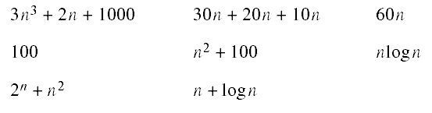
Exercise
  5-2 Rank the asymptotic orders of the following functions, from highest to lowest. (You may wish to graph some or all of them.)
26年 11月 8日
Copyright © 1997 Oxford University Press
All Rights Reserved

Slide 30
Figure 5-1: Sample record format
key
data
26年 11月 8日
Copyright © 1997 Oxford University Press
All Rights Reserved

Slide 31
Algorithm 5-1: Linear Search algorithm
For each item in the list
if the item’s key matches the target,
stop and report “success”
Report “failure”
26年 11月 8日
Copyright © 1997 Oxford University Press
All Rights Reserved

Slide 32
Code Example 5-1: Linear Search
// cx5-1.cpp
// Code Example 5-1: Linear Search
int linearSearch(int a[], int n, int target)
{
int i;
for (i = 0; i < n; i++)
if (a[i] == target) // key comparison
return i;
return -1; // use -1 to indicate failure
}
26年 11月 8日
Copyright © 1997 Oxford University Press
All Rights Reserved

Slide 33

Equation 5-1
Not exist(50%) + Found(50%) : assumption
average case는 항상 어떻게 assume 하는지에 따라 다르다
26年 11月 8日
Copyright © 1997 Oxford University Press
All Rights Reserved
Notes:
Average Case는, Data에 있을 확률과 없을 확률에 따라 다르다!
만약 찾고 싶은 목표가 Data에 없는 경우가 있다면,
찾고 싶은 목표가 모두 Data에 있다고 가정했을 때와 Average Case는 달라질 수 있다.
Not exist가 100%면? 70%면? 50%면? 0%면? 이 모든 경우 Average Case는 달라진다.
Not exist : ½ * n
Found : ½ * 1/n * (1+2+3+…+n)

Slide 34
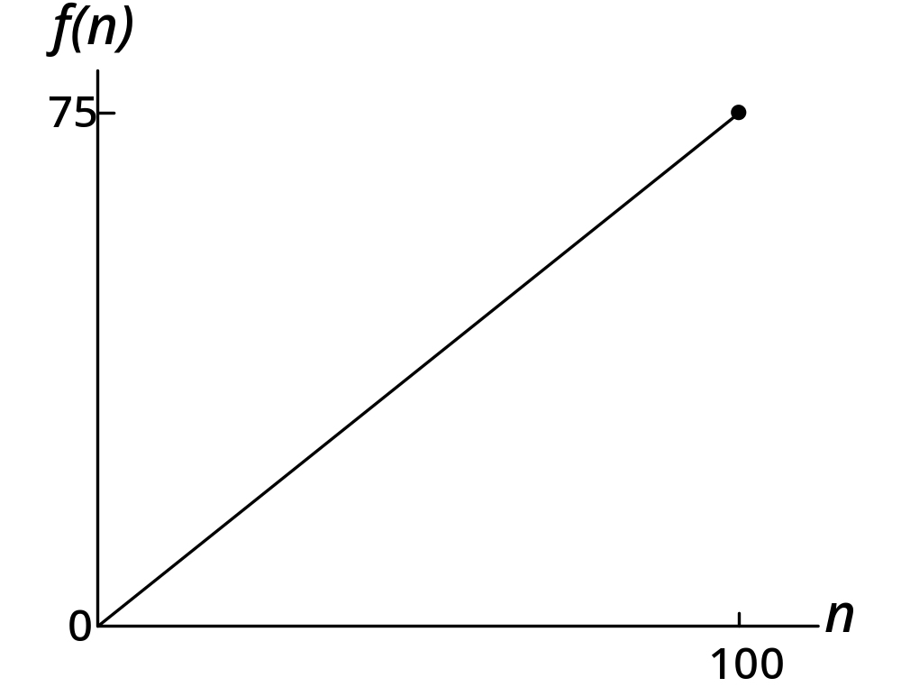
Figure 5-2: A graph of the average case performance of Linear Search
26年 11月 8日
Copyright © 1997 Oxford University Press
All Rights Reserved

Slide 35
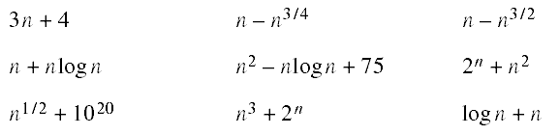
Exercise
  5-3 For the following formulas, identify the high-order term and indicate the order of each using big-O notation.
26年 11月 8日
Copyright © 1997 Oxford University Press
All Rights Reserved
Notes:
N-n^(3/2)는 무시하자!

Slide 36
Binary Search
Sorted items: 미리 정열되어야 하는 제약사항이 있음을 기억
compare a key with the middle item
if key > that of middle, search upper half
else, search lower half.
26年 11月 8日
Copyright © 1997 Oxford University Press
All Rights Reserved
Notes:
정렬이 되어야 사용할 수 있는 Binary Search!
n/2^k = 1이 될 때까지 내려가서 서치하게 된다.
따라서, binary Search의 시간복잡도는 O(lg N)이다.

Slide 37
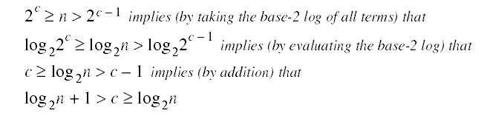
Equation 5-2
26年 11月 8日
Copyright © 1997 Oxford University Press
All Rights Reserved
Notes:
정렬이 되어야 사용할 수 있는 Binary Search!
n/2^k = 1이 될 때까지 내려가서 서치하게 된다.
따라서, binary Search의 시간복잡도는 O(lg N)이다. (lg N = log_2 N)
따라서 이 알고리즘은 빠르게 동작한다고 할 수 있다. 백만 개가 있으면 20번만 서치하면 되지 않은가?
단, 데이터가 사전에 정렬되어야 하므로, 갱신되는 데이터에는 사용하기 어렵다. (이 경우 linear Search가 더 나을 수 있으며, N lg N의 시간복잡도가 소요된다.)

Slide 38
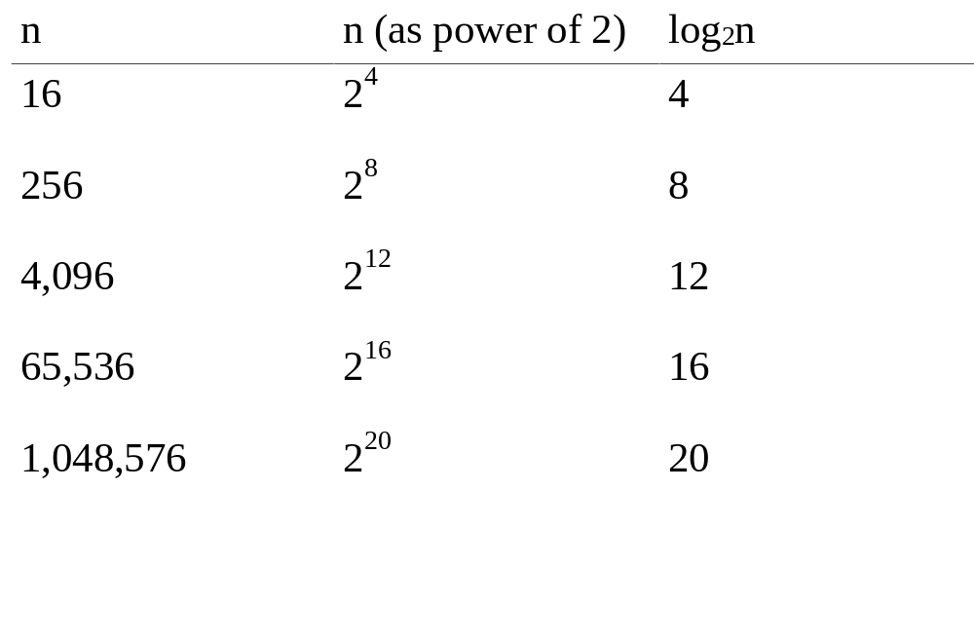
Table 5-1: The growth of the base-2 log function
26年 11月 8日
Copyright © 1997 Oxford University Press
All Rights Reserved

Slide 39
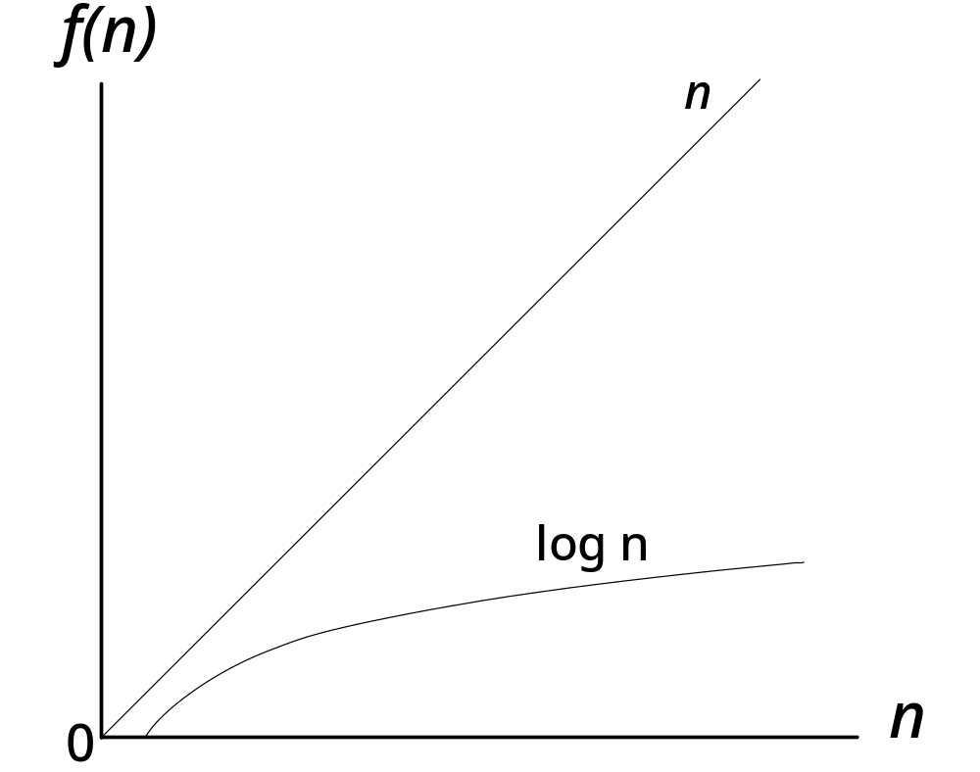
Graph illustrating relative growth of linear and logarithmic functions
26年 11月 8日
Copyright © 1997 Oxford University Press
All Rights Reserved

Slide 40
Code Example 5-2: Defective Binary Search
// cx5-2.cpp
// Code Example 5-2: Defective Binary Search -- Do Not Use!
int binarySearch(int a[], int n, int target)
{
// Precondition: array a is sorted in ascending order from a[0] to a[n-1]
int first(0);
int last(n - 1);
int mid;
while (first <= last) {
mid = (first + last)/2;
if (target == a[mid])
return mid;
26年 11月 8日
Copyright © 1997 Oxford University Press
All Rights Reserved
Notes:
1. 함수의 이름을 먼저 결정해보자! (매개 변수로 어떤 type을 받을지 생각해보기)
2. 가운데의 값과 비교해서 크면 왼쪽, 작으면 오른쪽
3. While문 loop를 해서, 데이터가 더 이상 없을 때 함수 종료
그러나 만약, 가운데를 기준으로 왼쪽의 개수와 오른쪽의 개수가 다르면…?
- loop시 문제가 생긴다!
따라서, 시작 값 ~ 끝 값을 함수의 인자로 받으면 어떨까? 하고 생각해본다!

Slide 41
Code Example 5-2: Defective Binary Search
else if (target < a[mid])
last = mid;
else // must be that target > a[mid]
first = mid;
}
return -1; // use -1 to indicate item not found
}
26年 11月 8日
Copyright © 1997 Oxford University Press
All Rights Reserved
Notes:
왼쪽 코드의 경우,
last = mid – 1; 이 맞다.
오른쪽 코드의 경우
first = mid + 1; 이 맞다.
만약 빼지 않을 경우, 언제나 1개가 반드시 남아 무한루프를 발생시킨다.

Slide 42
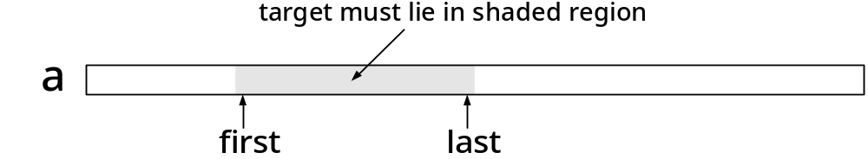
Figure 5-4
Illustrated Invariant for Binary Search
26年 11月 8日
Copyright © 1997 Oxford University Press
All Rights Reserved
Notes:
그러나 만약, 가운데를 기준으로 왼쪽의 개수와 오른쪽의 개수가 다르면…?
- 재귀호출시 문제가 생긴다!
따라서, 시작 값 ~ 끝 값을 함수의 인자로 받으면 어떨까? 하고 생각해본다!
이 ppt에는 first ~ last로 지정하였다!

Slide 43
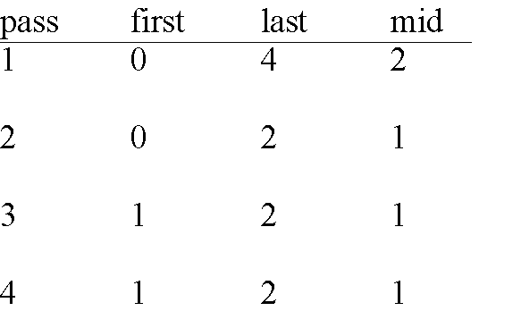
Table 5-2: Trace of Code Example 5-2 on Page 99
search 5 in {2,3,7,9,13}
26年 11月 8日
Copyright © 1997 Oxford University Press
All Rights Reserved

Slide 44
Code Example 5-3: Verified binary Search
int binarySearch(int a[], int n, int target)
{
// Precondition: array a is sorted in ascending order from a[0] to a[n-1]
int first(0);
int last(n - 1);
int mid;
while (first <= last) {
// Invariant: if target in a, then a[first] <= target <= a[last]
mid = (first + last)/2;
26年 11月 8日
Copyright © 1997 Oxford University Press
All Rights Reserved
Notes:
While문을 사용(loop)

Slide 45
Code Example 5-3: Verified binary Search
if (target == a[mid])
return mid;
else if (target < a[mid])
last = mid - 1;
else // must be that target > a[mid]
first = mid + 1;
}
return -1; //use -1 to indicate item not found
}
26年 11月 8日
Copyright © 1997 Oxford University Press
All Rights Reserved

Slide 46
Binary search vs. linear search
Binary search
  requires a sorted array
  Good for large list
  sometimes impractical to jump to middle of the list
Linear seach
  uses any array
  Good enough for short list
26年 11月 8日
Copyright © 1997 Oxford University Press
All Rights Reserved
Notes:
시험에 1점짜리로 나오는 문제
배열은 jump가 쉽지만, (index를 찾아서..)
Jump가 안되는(어려운) 자료구조 : stack, queue, …

Slide 47
Selection sort
Select largest items from the unsorted array
Move it to the sorted array
Done if all items are moved
26年 11月 8日
Copyright © 1997 Oxford University Press
All Rights Reserved
Notes:
Sort의 종류
- Insertion Sort (삽입 정렬) – 집어넣을 때가 중요
-> 1개부터 시작!
- Selection Sort (선택 정렬) – 뽑을 때(선택할 때)가 중요
-> 최댓값(or 최솟값)을 찾아서 뒤에서부터(앞에서부터) 정렬, 그 다음 최댓값(최솟값)을 찾아서 정렬….
-> inplace sorting이 가능
-> 0개부터 시작!
- bubble Sort (버블 정렬)
-> Bubble Sort는 Selection 계열 sort이다.

Slide 48
Algorithm 5-2:selection of max element
Max position <-- position of first item in the array
current position <-- position of second item in the array
while current position is not past the end of the array do
if item in current position is greater than item in max position then
max position <-- current position
current position <-- position of next item in the list
return max position
26年 11月 8日
Copyright © 1997 Oxford University Press
All Rights Reserved

Slide 49
Code Example 5-4: The maxSelect function
// cx5-4.cpp
// Code Example 5-4: Max Select function
int maxSelect(int a[], int n)
{
int maxPos(0), currentPos(1);
while (currentPos < n) {
// Invariant: a[maxPos] >= a[0] ... a[currentPos-1]
if (a[currentPos] > a[maxPos])
maxPos = currentPos;
currentPos++;
}
return maxPos;
}
26年 11月 8日
Copyright © 1997 Oxford University Press
All Rights Reserved
Notes:
// maxPos에 0을 할당, currentPos에 1을 할당
// 만약 maxPos보다 큰 값이 나타나면 maxPos 값 갱신

Slide 50
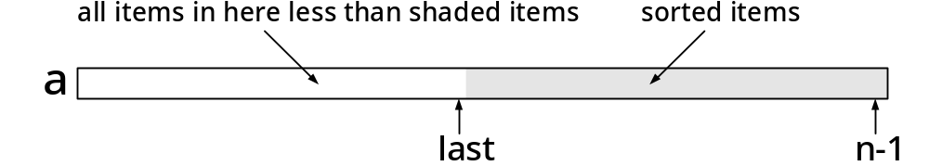
Figure 5-5: The operation of Selection Sort
26年 11月 8日
Copyright © 1997 Oxford University Press
All Rights Reserved
Notes:
Selection Sort
선택 정렬은 제자리 정렬 알고리즘의 하나로, 다음과 같은 순서로 이루어진다. 주어진 리스트 중에 최소값을 찾는다. 그 값을 맨 앞에 위치한 값과 교체한다. 맨 처음 위치를 뺀 나머지 리스트를 같은 방법으로 교체한다.
Insertion Sort
삽입 정렬은 자료 배열의 모든 요소를 앞에서부터 차례대로 이미 정렬된 배열 부분과 비교하여, 자신의 위치를 찾아 삽입함으로써 정렬을 완성하는 알고리즘이다. k번째 반복 후의 결과 배열은, 앞쪽 k + 1 항목이 정렬된 상태이다

Slide 51
Code Example 5-5: Selection Sort
// cx5-5.cpp
// Code Example 5-5: Selection Sort
void swapElements(int a[], int maxPos, int last); // see Exercise 5-12
int maxSelect(int a[], int n); // see cx5-4.cpp
void selectionSort(int a[], int n)
{
int last(n-1);
int maxPos;
26年 11月 8日
Copyright © 1997 Oxford University Press
All Rights Reserved
Notes:
만약 배열의 크기가 N이라고 한다면, 마지막 인덱스는 N-1이다.

Slide 52
Code Example 5-5: Selection Sort
while (last > 0) {
// invariant: a[last+1] ... a[n-1] is sorted &&
// everything in a[0] ... a[last] <= everything in a[last+1] ... a[n-1]
maxPos = maxSelect(a, last+1); // last+1 is length from 0 to last
swapElements(a, maxPos, last);
last--;
}
}
26年 11月 8日
Copyright © 1997 Oxford University Press
All Rights Reserved
Notes:
swapElements(a, maxPos, last);
// Array에서, Max값이 있는 index와 맨 마지막 index를 바꿔준다.

Slide 53


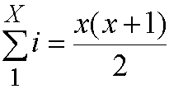

Analysis of selection sort
=
Since
26年 11月 8日
Copyright © 1997 Oxford University Press
All Rights Reserved
Notes:
Selection(Insertion) sort는 같은 complexity를 가진다. O(n^2)

Slide 54
Bubble sort
Moves items one at a time into a sorted region of the array
Sorting process looks like popping up of bubbles in water
At each phase, the unsorted array is passed through, comparing adjacent pairs of items, and exchanging the positions of the items in pairs that are out of order
26年 11月 8日
Copyright © 1997 Oxford University Press
All Rights Reserved
Notes:
Bubble Sort는 Selection 계열 sort이다.

Slide 55
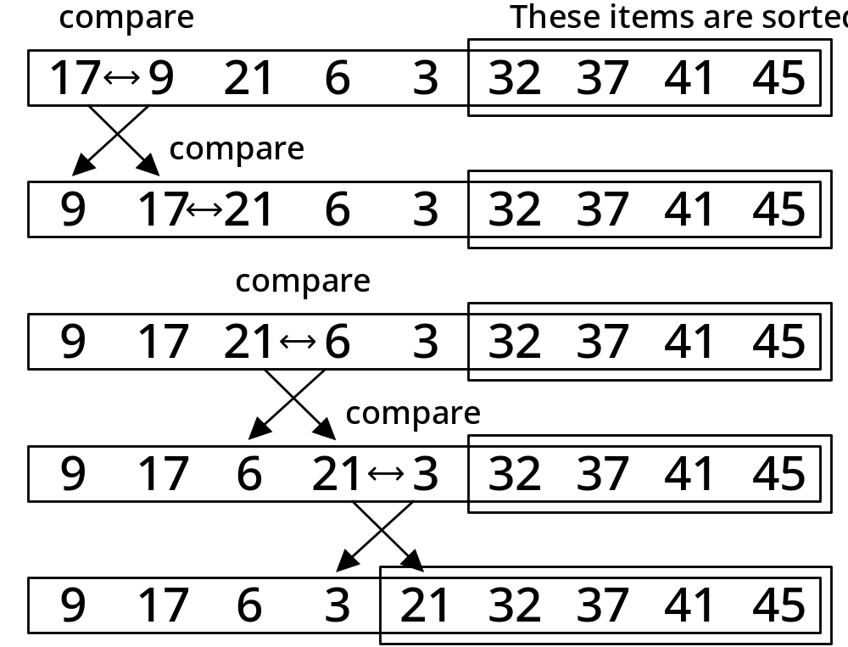
Example of one phase of Bubble Sort
26年 11月 8日
Copyright © 1997 Oxford University Press
All Rights Reserved
Notes:
데이터 자체가 계속 바뀌면서 올라간다.
위 그림에서, 맨 오른쪽에는 가장 큰 값이 들어간다.
Index만 바뀌고 data는 바뀌지 않는다. (data의 위치만 바뀔 뿐이다.) / 이 sort의 경우 swap에 무게가 두고 있다.
그러나 swap하는 연산은 그리 크지 않으므로 작은 데이터를 정렬할 때는 괜찮다.

Slide 56
Code Example 5-6: bubbleSortPhase
// cx5-6.cpp
// Code Example 5-6: Bubble Sort Phase
void swapElements(int a[], int maxPos, int last); // see Exercise 5-12
void bubbleSortPhase(int a[], int last)
{
// Precondition: a is an array indexed from a[0] to a[last]
// Move the largest element between a[0] and a[last] into a[last],
// by swapping out of order pairs
int pos;
26年 11月 8日
Copyright © 1997 Oxford University Press
All Rights Reserved
Notes:
마지막 인덱스 앞에까지만 비교하여 swap한다. (나랑, 내 뒤에꺼랑!)
근데 마지막 인덱스까지 하면 (나랑, 내 뒤에꺼랑(이게 없어서 오류!))

Slide 57
Code Example 5-6: bubbleSortPhase
for (pos = 0; pos < last ; pos++)
if (a[pos] > a[pos+1]) {
swapElements(a, pos, pos+1);
}
// Postconditions: a[0] ... a[last] contain the same elements,
// possibly reordered; a[last] >= a[0] ... a[last-1]
}
26年 11月 8日
Copyright © 1997 Oxford University Press
All Rights Reserved

Slide 58
Code Example 5-7: Bubble Sort
// cx5-7.cpp
// Code Example 5-7: Bubble Sort
void bubbleSortPhase(int a[], int last); // see cx5-6.cpp
void bubbleSort(int a[], int n)
{
// Precondition: a is an array indexed from a[0] to a[n-1]
int i;
for (i = n - 1; i > 0; i--)
bubbleSortPhase(a, i);
// Postcondition: a is sorted
}
26年 11月 8日
Copyright © 1997 Oxford University Press
All Rights Reserved

Slide 59

Equation 5-7
26年 11月 8日
Copyright © 1997 Oxford University Press
All Rights Reserved
Notes:
Selection Sort, Insertion Sort, Bubble Sort 모두 O(N^2)의 시간복잡도를 가지며, 추가적인 메모리를 요구하지 않는다.
For문을 2번 돌리기보다는, 함수 모듈화해서 예쁘게 짜기를 권장함! (디버깅에 유리하고, 유지보수에 좋음!)

Slide 60
실습예제
Selection sort 를 decreasing order 가 되게 구현하시오. 현재 교과서에 있는 구현은 increasing order 이다.
26年 11月 8日
Copyright © 1997 Oxford University Press
All Rights Reserved
Notes:
제일 큰 값을 맨 앞으로 가게 하면 된다! OR
제일 작은 값을 맨 뒤로 가게 하면 된다!

